Slide 1

Data Science with Advanced Python

Slide 2
Objectives
To present concepts like Data Science and Machine Learning in a simple, illustrative way
To practically demonstrate associated topics like EDA, data manipulation and touch upon data pre-processing, model training, prediction with Python, using a simple case study

Slide 3
Key takeaways
Conceptual understanding of Data Science, Pandas, dataframe, EDA, data manipulation
Conceptual understanding of Machine Learning, data pre-processing, model training and a brief on some machine learning models

Slide 4
Pipeline overview
Raw data
Data cleaning
Data pre-processing
Data splitting
Deployment
Value prediction of target variable
Cross validation
Training ML model

Slide 5
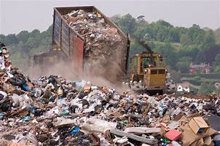

Data science
Reading data
Patterns
Mathematics, Statistics and Coding

Slide 6
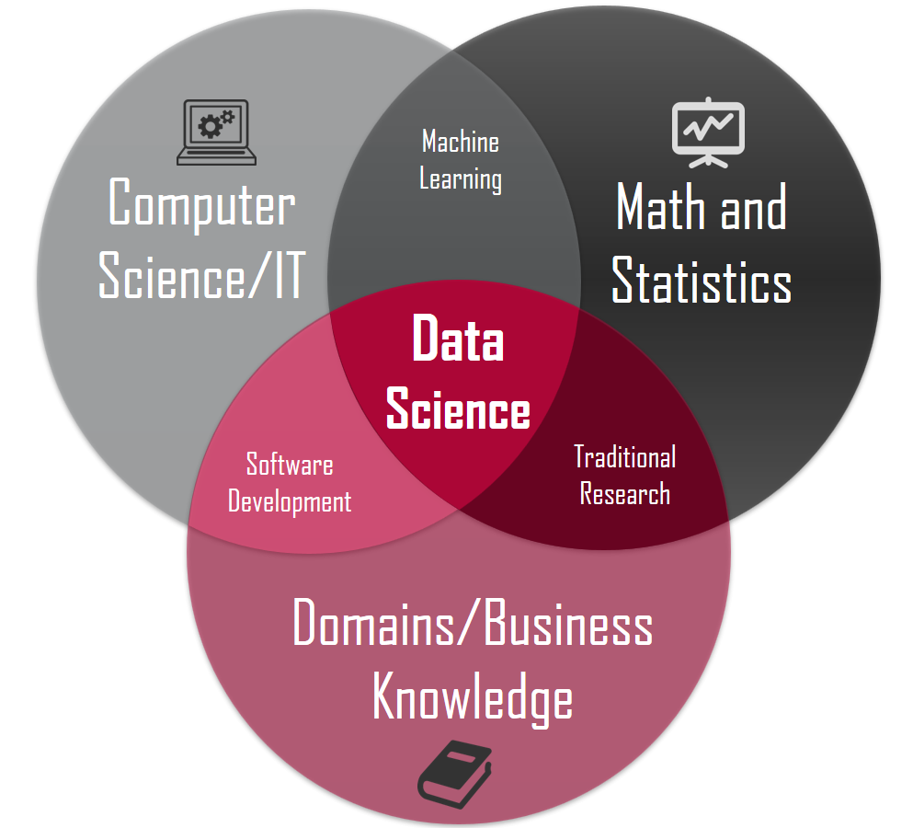
Data science

Slide 7
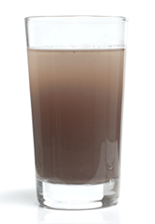
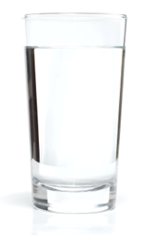
Exploratory data analysis
Reading raw data from files and viewing it
Numerically and/or graphically viewing the data distribution
Classifying categorical and numerical data
Cleaning the data
Checking for missing values
Data manipulation

Slide 8
Installing pip & pandas
Install pip
You have it
pip –V
python -m pip install --upgrade pip
You don’t have it (This will install pip at system level)
Download get-pip.py in folder X
Open cmd and go to X -> python get-pip.py
Pip –V
Install pandas library – Python data analysis library – 2221 functions
Import pandas library
Read csv file into a dataframe

Slide 9
Reading raw data
Read csv file into a dataframe
read_csv()
path
Encoding – 97 options – latin-1/utf-8
Remove duplicates and see dimensions
dataframe() method
df = df.drop_duplicates()
df.shape
View no. of rows and columns

Slide 10
Row & column ops
Add a new row
df.append() method
pd.concat() method
Delete the added row
drop() method, index() and axis arguments
Delete any specific row
drop() method, index() and axis arguments
Delete the added column or any specific column
drop() method, index(), columns() and axis arguments

Slide 11
Date handling
Creating a medical_table dataframe to demonstrate date handling
Creating a datetime variable
pd.date_range() method
Formatting
re.sub() method
apply() method
datetime.datetime.strptime() method (always returns YYYY-MM-DD)

Slide 12
Thank You!

Slide 13
References
Pandas resource pandas.read_html — pandas 1.5.1 documentation (pydata.org)
Read csv file into a dataframe pandas.DataFrame — pandas 1.5.1 documentation (pydata.org)
Pandas date_range pandas.date_range — pandas 1.5.1 documentation (pydata.org)
Random library https://www.w3schools.com/python/module_random.asp
re module https://www.w3schools.com/python/python_regex.asp
Regex applications Python - Substituting patterns in text using regex – GeeksforGeeks
Print alphabets Python list of letters a-z - PythonProgramming.in
Pandas convert date string to datetime Pandas Convert Column To DateTime - Spark by {Examples} (sparkbyexamples.com)

